Slide 1
Keeping young people safe online
Elthorne Park High School Parent Workshop

Slide 2
Meet the health improvement team
Karen Gibson
HIT manager Safeguarding
Nicole McGregor
Nutrition & exercise
Officer
Faye Jones
PSHE & RSHE
Officer
Liz Ainsworth
Mental health and wellbeing Officer

Slide 3
Areas we will cover in this training:
Digital Literacy and Digital Defence
Online Safety in the Curriculum
Harmful Content online
Parental Guidance

Slide 4
What do we aim to protect children from when they are outside the home?
Exposure to drugs and alcohol
Strangers
Sexual Exploitation
Violence
Gangs and Peer Pressure
All of these things areas remain risk factors to young people when they safe within the home but spending time online!

Slide 5
Teaching Digital Literacy and Digital Defence
What adults see as a separate online world, children and young people see as a normal part of theirs.
Schools and parents have a joint responsibility for ensuring that all children have the knowledge and skills to live happy and healthy lives.
This means ensuring they know how to live respectfully and safely in their hybrid world of being offline and online.
The internet is a great resource for learning and socialising and there are many benefits for young people. It is going to always be a part of children's lives so internet safety skills are just as important as the other skills they learn in school.
Children need to be skilled in both digital literacy and digital defence. These are skills which are taught within school as part of the PSHE curriculum and embedded within the home.

Slide 6
Teaching Digital Literacy and Digital Defence
Digital Literacy
Digital Literacy involves teaching children and young people how to engage
safely, respectfully and positively online.
It ensures that they use the online platforms children use are empowering and contributing to their wellbeing by providing
knowledge, positive socialisation or play.
Digital Literacy will constantly be developed as children get older and discover more. It will be a key skill needed for their success in academic, the workplace and their social lives.
Digital Defence
Digital Defence is a mechanism of
protection and safeguarding.
Children and young people need to be taught how to keep themselves safe online, how to recognise potential harm and what to do when it occurs.
Children should also be encouraged to share and communicate about their online experiences with the focus being on inclusion and engagement with their parents and carers rather than punitive supervision.

Slide 7
4 areas of online safety and safeguarding
Content
Contact
Conduct
Commerce
WHAT
children might see
WHO
might to speak to children
HOW
children use the internet
FINANCIAL RISKS
i.e Gambling, Scams Advertising

Slide 8
Statutory Relationships, Sex and Health Education
Relationships Education:
Families
Respectful Relationships Including Friendships
Online And Media
Being Safe
5. Intimate Sexual Relationships Including Sexual Health
Health and wellbeing
Mental Wellbeing
Internet Safety And Harm
Physical Health And Fitness
Healthy Eating
Drugs, Alcohol And Tobacco
Health And Prevention
Basic First Aid
Changing Adolescent Body
The same topic headings are used in both the primary and secondary curriculum, the expectation for a spiral curriculum is made clear in the guidance.

Slide 9
Statutory Relationships, Sex and Health Education
Relationships Education:
Online And Media
Rights, responsibilities and opportunities online, including that the same expectations of behaviour apply in all contexts, including online.
Online risks, caution in sharing material and the difficulty of removing material placed online.
Not to share personal material which is sent to them.
What to do and where to get support to report material or manage issues online.
The impact of viewing harmful content.
How information and data is generated, collected, shared and used online.
Health and wellbeing
Internet Safety And Harm
The benefits of rationing time spent online,
Impact of content their own and others’ mental and physical wellbeing.
How to recognise and display respectful behaviour online and the
Importance of keeping personal information private.
Age restricted materials purpose
Recognising abuse can happen online
Critical engagement with resources
Where to get help

Slide 10
Content
Harmful Content
It is important to remember children may be exposed to harmful content through their own actions but more often it is unintentional.
The majority of young people's first time watching pornography was accidentally
62% of 11-13 year olds who had seen pornography reporting that they stumbled across it unintentionally. With children as young as six and seven report accidentally seeing pornography online.
Children described feeling “grossed out” and “confused”, particularly those who had seen pornography when they were under the age of 10.
Source: British Board of Film Classifications, 2019

Slide 11
Content
Harmful Content
Research by the children's commissioner for England found 10% of children have viewed pornography by the time they are 9 years old and 27% by the time they are 11.
The average age of exposure is 13.
Recommendations from teenagers in the study said parents should:
Consider delaying providing a smartphone to their children
Ask their children what they are viewing
Consider family boundaries around phone use, not phones in the bedroom especially before bed, dedicated family time, avoiding double screening.
Dame Rachel de Souza
Childrens Commisoner

Slide 12
Content
Harmful Content-
Recommendations from Teens
Research by the children's commissioner for England found 10% of children have viewed pornography by the time they are 9 years old and 27% by the time they are 11.
The average age of exposure is 13.
Recommendations from teenagers in the study said parents should:
Consider delaying providing a smartphone to their children
Ask their children what they are viewing
Consider family boundaries around phone use, not phones in the bedroom especially before bed, dedicated family time, avoiding double screening.

Slide 13
Content
Harmful Content
Pornography is not the only harmful content that children may witness online.
Harmful Content can also include:
Extreme Violence and Aggression
Substance Misuse
Peer to Peer Sexual Imagery
Extremist Materials
Fake News
Glamorising of Crime and Gang Involvement
Animal Abuse
Expose to these forms of content can be seen in Film, TV, Social Media Platforms, Music Videos and Gaming.

Slide 14
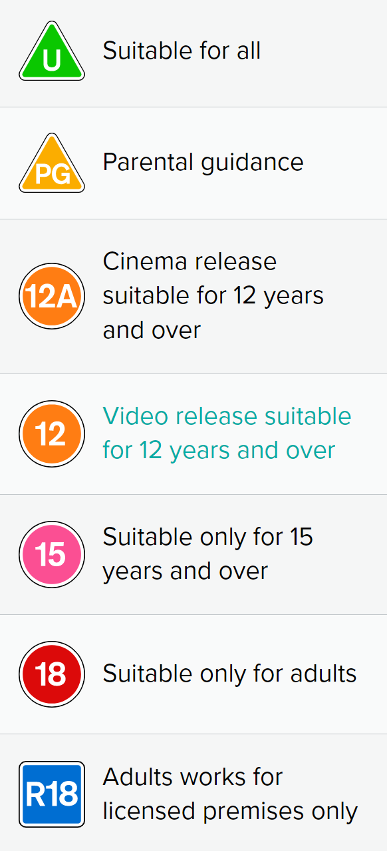
Content
We will all be familiar with recognising age restrictions on film and video games but how familiar are you with the age restrictions on these popular apps?
Age Restrictions
12+

Slide 15
Contact
Online Chat
Concerns over who children are talking to online is an increasing concern.
Popular social networking sitess such as snapchat, Instagram and Tik Tok have online communication at the core. They encourage children to share, like and comment. Engaging not just with their peers but their favourite influencers and accounts.
However gaming sites such as Among us, Roadblox, Fortnite and Minecraft have integrated chatrooms in which players can communicate.
It is important to have regular communication with your children about who they are communicating with online.
Ensure where possible children are online gaming in areas of visibility and where conversations may be monitored.

Slide 16
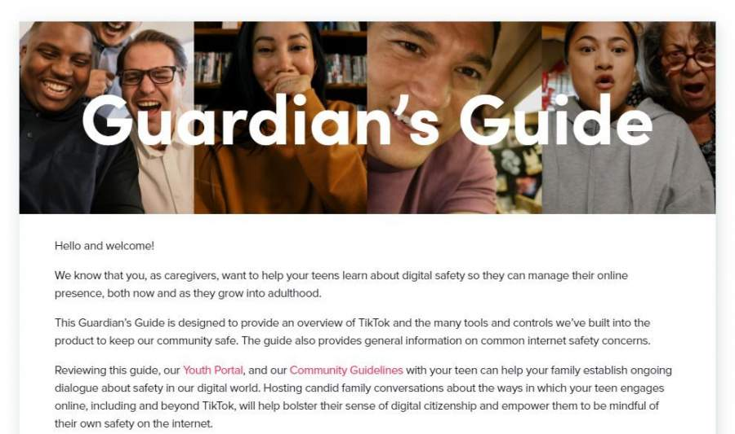
Contact
Parent Guides
The Guardians Guide to TIK TOK
includes information on setting up Family Pairing
Ensures accounts remain private
Direct Messaging is blocked
Parents can monitor the pages children are following
Time controls

Slide 17
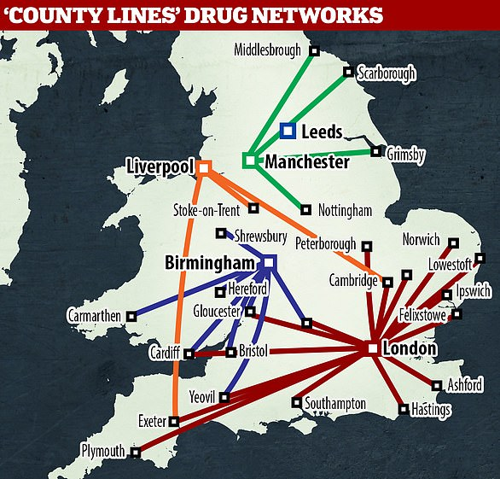
Contact
Grooming- County Lines

Slide 18
Conduct
Cyber-Bullying
Statistics from 2021 show across the UK,
almost 1 in every 5 (19%) children aged 10-15 experience cyber bullying, equating to around 764,000 children.
The most common method of online bullying were
Nasty messaging
Being sworn at and
Being called insulting names
Ditch the Label, 2020

Slide 19
Conduct
Sexual Harassment- ‘Sending Nudes’
Peer to peer sexual abuse, both offline and online has been well documented.
Ofsted’s review into sexual abuse in schools (2021) documented the endless pressure on girls to send nude images, with girls being targeted by several of their peers a day.
Beginning conversations on consent and privacy from a young age helps set foundations that encourage safe behaviour in the future.
Children are taught about the law around sending nudes in school. It is reinforced that generating (taking the photograph), sharing or saving it on to their phone is considered illegal child pornograpghy.
Children use sites like snapchat to send nudes thinking they are protected but images can be saved and screenshot.
Airdrop has also allowed young people to send images to multiple people very quickly and without trace.
Many young people who have shared an image with a peer may feel like they can’t talk to a parent due to shame or fear. This can lead to delays in getting the image removed from the online site.

Slide 20
Conduct
Reporting
Ensure your children know how to use the report features in the apps they are using and encourage them to talk to you.
Children may be fearful that they have done something wrong or will be in trouble for their actions online, ensuring that your first priority is always their wellbeing and safety opens opportunities for them to talk.
External organisations such as CEOP and the NSPCC are also safe places for children to report online harm.

Slide 21
Conduct
Reporting- Project deSHAME
Project deSHAME worked with over 3000 12-17 year olds across Europe around online sexual harassment. It found…
64% of young people had seen people they knew shamed online for sexual behaviour
29% of young people had seen sexual threats made against someone they knew online
50% young people wouldn’t tell a teacher as they were afraid of how they would react
53% of young people won’t tell the police as they are afraid of their family getting involved
43% of young people won’t report it to the social media platform as they think it won’t help.
Tackling online sexual harassment - A film for parents and carers - YouTube

Slide 22
Commerce
Social Media and Advertisement
YoungMinds found 75% of young people have experienced periods of low self-esteem at least once before the age of 13.

Slide 23
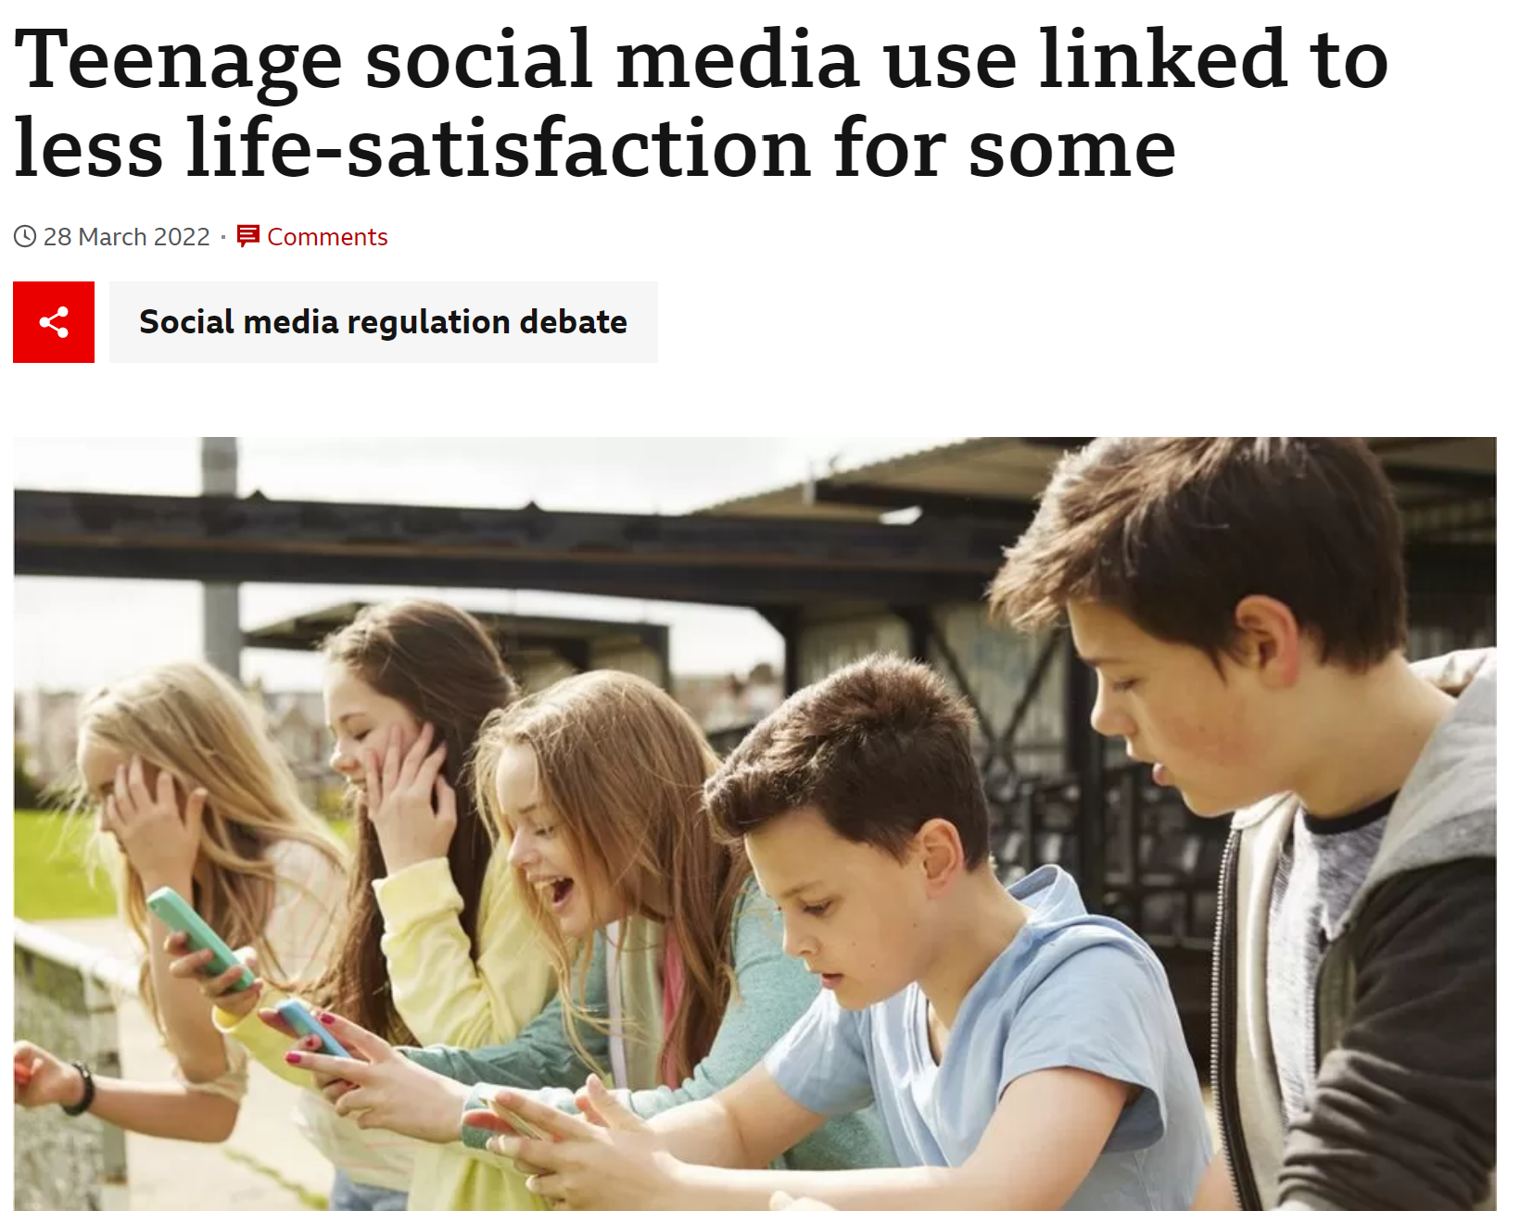
The study suggests among girls aged 11 to 13, those who had increased their social media in the last 12 months use were less satisfied with life a year later.

Slide 24
Commerce
Gaming to Gambling…
Social Media and Gaming platforms are using the same psychological methods of enticement that lead to Gambling Addiction in adults.
Monitor children’s time online
Supervise children if they are playing games on devices which have apple pay or easy pay options set up.
Discuss how being on social media is making children feel.

Slide 25
Commerce
Who is Andrew Tate?
Andrew Tate is a former kickboxer who rose to fame in 2016 when he was removed from TV show Big Brother over a video which appeared to depict him attacking a woman.
His influence on social media grew as he continued to share his ‘millionaire lifestyle’. Tate’s became of concern as he used his wide-reaching platform to share his concerning views on women.
Tate was banned from Twitter for saying women should "bear responsibility" for being sexually assaulted. He has since been reinstated.
Numerous social media platforms, including YouTube, Facebook, Instagram and TikTok, have banned him - with the latter saying that "misogyny is a hateful ideology that is not tolerated".
Tate and his brother have been arrested and are currently being investigated for Human Trafficking and rape crimes.

Slide 26
Commerce
Toxic Influencing
"I'm a realist and when you're a realist, you're sexist.
There's no way you can be rooted in reality and not be sexist."
In an interview with another YouTuber, he said he was "absolutely a misogynist".
In that same video, he described women as "intrinsically lazy" and said there was "no such thing as an independent female".
Young boys are particularly drawn into the flash lifestyle, promise of cars, money and fame and are slowly exposed into toxic ideas against women.
Schools across the UK have had growing concern over the comments and behaviours that young boys are expressing in
Misogyny: dislike of, contempt for, or ingrained prejudice against women.

Slide 27
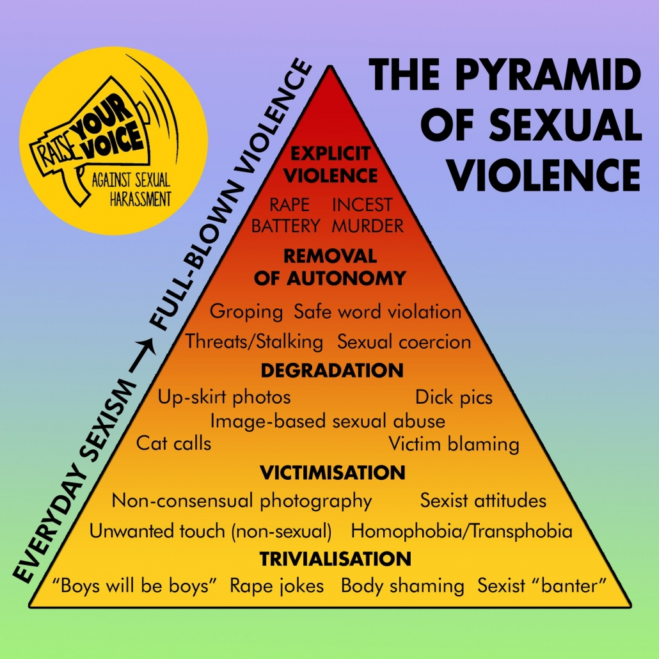
Commerce
Avoiding Escalation

Slide 29
Commerce
Top Takeaways…
Access to the internet is not going to disappear and it can have huge benefits for leisure, socialising and education. It is not about removing access but upskilling young people in using it.
Communicate! Ask what your children are playing, communicating on and accessing. Make this regular so dialouge is open.
Begin the conversations about the pressure to send or receive news, use documentaries or videos as a stimulus for the conversation. Ensure children know they can talk to you and how they can report.
Talk about Mental Health and Online Safety, is their feed only showing them one type of body, are they using filters in all their photos?
Set clear boundaries around phone use and model it. Are you double or triple screening in an evening? Do you have no phones at dinner? Are there curfews on the internet in the morning or evening.

Slide 30
DIGISAFE- Parent SAFE
Home (lgfl.net)
Everything you need to know in one place…
Tools for you to check out:
Family Digital Agreement
Tools and games on how to have conversations about online safety
Safe Settings- Apple Screen Time, Google Family Link, Youtube Supervised

Slide 31
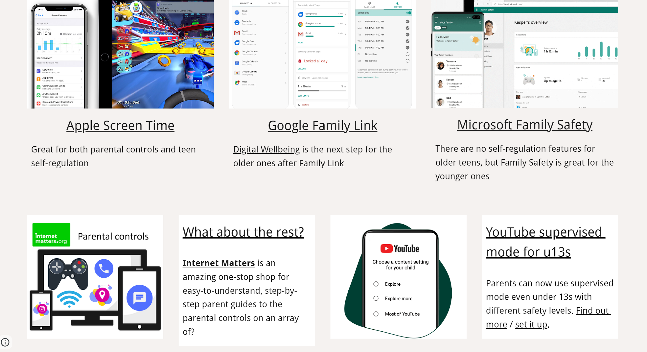
DIGISAFE- Parent SAFE
Home (lgfl.net)
Everything you need to know in one place…

Slide 32
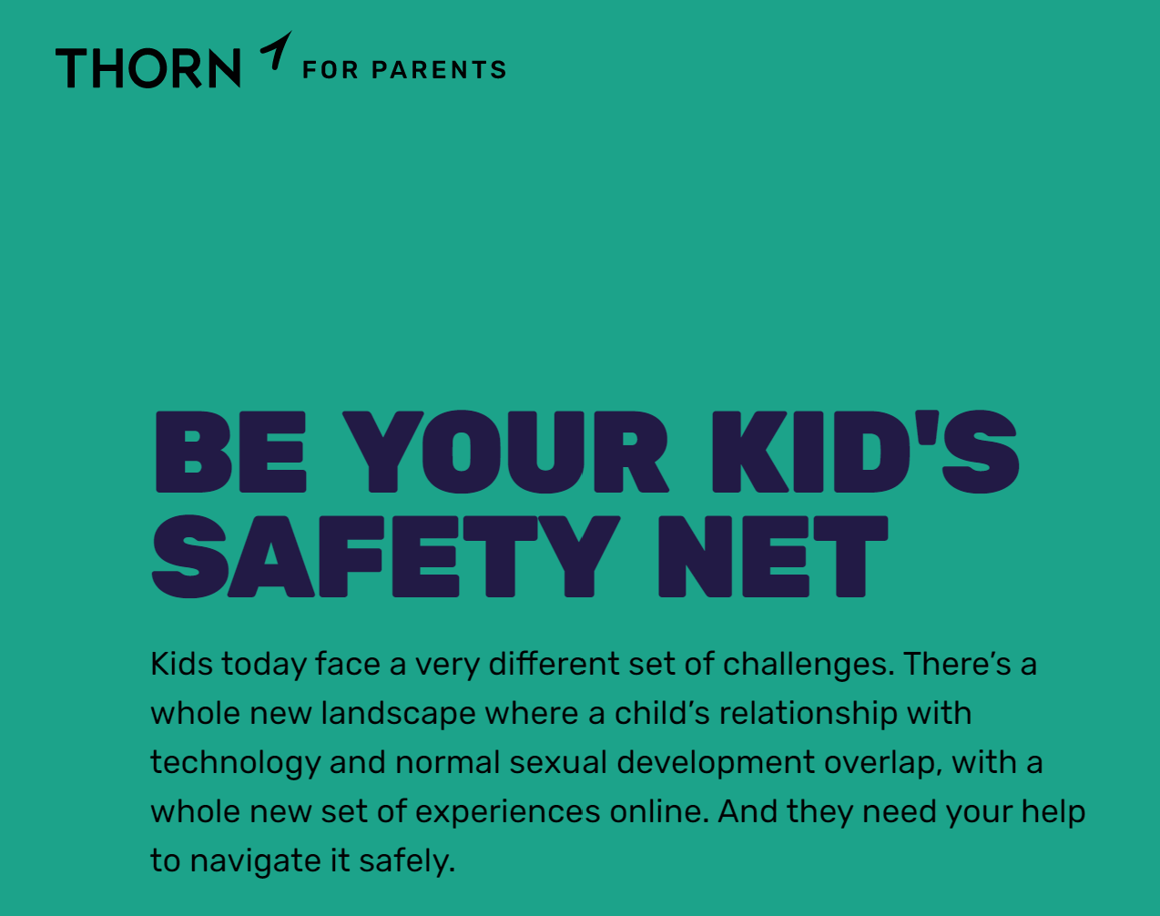

Slide 33
Notes:
‹#›

Slide 34
Thank you for attending

