Slide 1
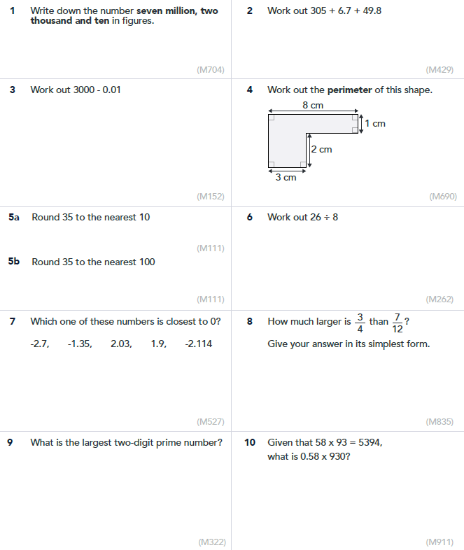
EPHS Maths Department - Year 6 into Year 7
These questions are designed to support the transition of Year 6 learning into Year 7. Remember to show your working out and to bring this with you to your first Maths lesson.

